Slide 1




Noida Institute of Engineering and Technology, Greater Noida
(An Autonomous Institute)
School of Computer Science & Engineering in Emerging Technologies
Capgemini Training on HTML
Day: 3
Subject Name:
WEB TECHNOLOGY
Mr. Amar Pal Yadav
Assistant Professor
CSE & ET (AI Department)
Course Details
(B Tech. 7th Sem)
Mr. Amar Pal Yadav Workshop on Web. Tech. Day-2

Slide 2

Brief introduction of faculty Member
Mr. Amar Pal Yadav
Designation: Assistant Professor CSE&ET (AI )
NIET, Greater Noida (Code-133)
Qualification:
  B.Tech(IT)
  M.Tech(SE), Specialization: Software Engineering
  Ph.D.* (CSE)
Teaching Experience: 14 years
Research Publication
  Paper Published: 8(International Journal)
Coursera Course
  Coursera Course Completed: 15
Mr. Amar Pal Yadav Workshop on Web. Tech. Day-2
5

Slide 3
Web Technology
Day-1 (Topic to be covered)
  HTML,
  DOM- Introduction to Document Object Model,
  Basic structure of an HTML document,
  Mark up Tags,
  Heading-Paragraphs,
  Line Breaks,
  Understand the structure of HTML tables
Mr. Amar Pal Yadav Workshop on Web. Tech. Day-2

Slide 4
Day-1 Workshop on Web Tech
  HTML (Hyper Text Markup Language) and HTML5 are both markup languages used to create and structure content on the web.
  HTML5 is the latest version of HTML and introduces several new features and improvements over its predecessors.
  Here's a detailed comparison highlighting the key differences between HTML and HTML5
Mr. Amar Pal Yadav Workshop on Web. Tech. Day-2

Slide 5
Day-1 Workshop on Web Tech
  <html lang="en“>
The lang attribute in the HTML <html> tag specifies the language of the content of the web page.
This helps browsers, search engines, and assistive technologies (like screen readers) understand the primary language of the page content, which can improve accessibility, search engine optimization (SEO), and the overall user experience.
Example: html lang="en"The attribute lang="en" indicates that the primary language of the page content is English.
Mr. Amar Pal Yadav Workshop on Web. Tech. Day-2

Slide 6
Day-1 Workshop on Web Tech
  <meta charset="UTF-8">
  The <meta charset="UTF-8"> tag in HTML specifies the character encoding for the HTML document.
  Character encoding determines how characters are represented in bytes, which is crucial for displaying text correctly on web pages.
  Syntax
  <meta charset="UTF-8">
  <meta>: This is an HTML tag that provides metadata about the HTML document.
  charset: This attribute specifies the character encoding.
  "UTF-8": This is the value of the charset attribute, indicating that the character encoding is UTF-8.
Mr. Amar Pal Yadav Workshop on Web. Tech. Day-2

Slide 7
Day-1 Workshop on Web Tech
  Wide Compatibility: UTF-8 can represent any character in the Unicode standard, which includes characters from almost all languages, special symbols, and emojis.
  Efficiency: For texts primarily in English (and other languages with mostly ASCII characters), UTF-8 is space-efficient because it uses only one byte for the first 128 characters.
  Global Standard: UTF-8 is the most widely used character encoding on the web. It ensures that your content is consistently displayed across different browsers and platforms.
  Improved Accessibility: UTF-8 supports a vast array of characters and symbols, making your content accessible to a global audience.
Mr. Amar Pal Yadav Workshop on Web. Tech. Day-2

Slide 8
Day-1 Workshop on Web Tech
  Benefits
  1. Correct Display of Characters: Ensures that characters from different languages and symbols are displayed correctly.
  Prevents issues like "mojibake" (garbled text) that can occur when the wrong character encoding is used.
  2. Search Engine Optimization (SEO): Proper encoding helps search engines correctly index your content.
  3. Consistency Across Browsers: Ensures that the web page displays consistently across different browsers and devices.
  It sets the character encoding to UTF-8, which supports a wide range of characters and symbols, making your web content accessible and correctly displayed to a global audience.
Mr. Amar Pal Yadav Workshop on Web. Tech. Day-2

Slide 9
Day-1 Workshop on Web Tech
  <!DOCTYPE html>
  <html lang="en">
  <head>
  <meta charset="UTF-8">
  <title>Example Page</title>
  </head>
  <body>
  <h1>Hello, world!</h1>
  <p>This page is using UTF-8 character encoding.</p>
  </body>
  </html>
Mr. Amar Pal Yadav Workshop on Web. Tech. Day-2

Slide 10
Day-1 Workshop on Web Tech
  HTML:
HTML stands for Hyper Text Markup Language
HTML is the standard markup language for creating Web pages
HTML describes the structure of a Web page
HTML consists of a series of elements
HTML elements tell the browser how to display the content
HTML elements label pieces of content such as "this is a heading", "this is a paragraph", "this is a link", etc.
HTML is an acronym which stands for Hyper Text Markup Language which is used for creating web pages and web applications. Let's see what is meant by Hypertext Markup Language, and Web page.
Mr. Amar Pal Yadav Workshop on Web. Tech. Day-2

Slide 11
Day-1 Workshop on Web Tech
  HTML…
An HTML document is made of many HTML tags and each HTML tag contains different content.
<!DOCTYPE html>
<html>
<head>
<title>Page Title</title>
</head>
<body>
<h1>My First Heading</h1>
<p>My first paragraph.</p>
</body>
</html>
Mr. Amar Pal Yadav Workshop on Web. Tech. Day-2

Slide 12
Day-2 Workshop on Web Tech
  HTML…
Example Explained
The <!DOCTYPE html> declaration defines that this document is an HTML5 document
The <html> element is the root element of an HTML page
The <head> element contains meta information about the HTML page
The <title> element specifies a title for the HTML page (which is shown in the browser's title bar or in the page's tab)
The <body> element defines the document's body, and is a container for all the visible contents, such as headings, paragraphs, images, hyperlinks, tables, lists, etc.
The <h1> element defines a large heading
The <p> element defines a paragraph
Mr. Amar Pal Yadav Workshop on Web. Tech. Day-2

Slide 13
Day-2 Workshop on Web Tech
  2. DOM- Introduction to Document Object Model:
Document Object Model:
The Document Object Model is a cross-platform and language-independent interface that treats an XML or HTML document as a tree structure wherein each node is an object representing a part of the document. The DOM represents a document with a logical tree.
Mr. Amar Pal Yadav Workshop on Web. Tech. Day-2

Slide 14
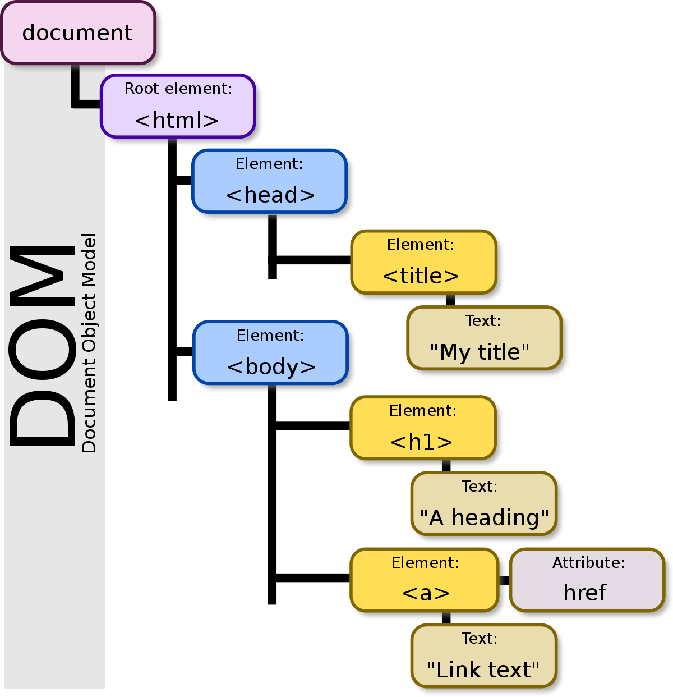
Day-2 Workshop on Web Tech
Mr. Amar Pal Yadav Workshop on Web. Tech. Day-2

Slide 15
Day-2 Workshop on Web Tech
  3. Basic structure of an HTML document:
HTML Element
An HTML element is defined by a start tag, some content, and an end tag:
<tagname> Content goes here... </tagname>
Mr. Amar Pal Yadav Workshop on Web. Tech. Day-2

Slide 16
Day-2 Workshop on Web Tech
  3. Basic structure of an HTML document…
Structure of HTML
<html>
<head>
<title>Page title</title>
</head>
<body>
<h1>This is a heading</h1>
<p>This is a paragraph.</p>
<p>This is another paragraph.</p>
</body>
</html>
The content inside the <body> section (the white area above) will be displayed in a browser. The content inside the <title> element will be shown in the browser's title bar or in the page's tab.
Mr. Amar Pal Yadav Workshop on Web. Tech. Day-2

Slide 17
Day-2 Workshop on Web Tech
  4. Mark up Tags:
  Markup language: A markup language is a computer language that is used to apply layout and formatting conventions to a text document.
  Markup language makes text more interactive and dynamic. It can turn text into images, tables, links, etc.
  Web Page: A web page is a document which is commonly written in HTML and translated by a web browser. A web page can be identified by entering an URL.
  A Web page can be of the static or dynamic type. With the help of HTML only, we can create static web pages.
Mr. Amar Pal Yadav Workshop on Web. Tech. Day-2

Slide 18
Day-2 Workshop on Web Tech
  4. Mark up Tags…
A “markup tag” is the fundamental characteristic of HTML. Every markup tag is a command placed between “wickets” or “angle brackets”—a left bracket (<) and a right bracket (>). Markup tags are not revealed by a web browser; they are invisible.
In most cases, markup tags (containing commands) come in pairs, with text or a graphic image located between the beginning and ending tags:
<COMMAND>text or graphic image</COMMAND>: controls or regulates the text or graphic image information between the two non-empty markup tags.
Mr. Amar Pal Yadav Workshop on Web. Tech. Day-2

Slide 19
Day-2 Workshop on Web Tech
  4. Mark up Tags…
Pairs of markup tags are referred to as “non-empty” tags, because something is contained between the beginning tag and the ending tag. A beginning tag and an ending tag are identical, except a “slash” (/) is placed before the command of the ending tag to tell the browser that the command has been completed.
Mr. Amar Pal Yadav Workshop on Web. Tech. Day-2

Slide 20
Day-2 Workshop on Web Tech
  5. Heading <h> tag:
In HTML, the <h1> to <h6> tags are used to define headings.
These tags represent headings of different levels, with <h1> denoting the highest level and <h6> denoting the lowest.
Headings are used to define the structure of a document, with <h1> being the main heading of the page, followed by subheadings represented by <h2>, <h3>, and so on.
Mr. Amar Pal Yadav Workshop on Web. Tech. Day-2

Slide 21
Day-2 Workshop on Web Tech
  5. Heading <h> tag…
<!DOCTYPE html>
<html>
<head>
<title>Heading Tags Example</title>
</head>
<body>
<h1>This is a Heading Level 1</h1>
<p>Some content here.</p>
<h2>This is a Heading Level 2</h2>
<p>Some more content here.</p>
<h3>This is a Heading Level 3</h3>
<p>Even more content here.</p>
</body>
</html>
Mr. Amar Pal Yadav Workshop on Web. Tech. Day-2

Slide 22
Day-2 Workshop on Web Tech
  5. Heading <h> tag…
In this example, <h1> is the main heading, <h2> is a subheading under <h1>, and <h3> is a subheading under <h2>. You can continue this pattern down to <h6>.
The heading tags not only define the visual appearance of the text
(larger font size and bold), but they also convey the document’s structure to browsers and assistive technologies, making it important for accessibility and search engine optimization (SEO).
Mr. Amar Pal Yadav Workshop on Web. Tech. Day-2

Slide 23
Day-2 Workshop on Web Tech
  Paragraphs <p> tag:
A paragraph always starts on a new line, and browsers automatically add some white space (a margin) before and after a paragraph. HTML paragraph or HTML p tag is used to define a paragraph in a webpage.
An HTML <p> tag indicates starting of new paragraph.
Example of HTML Paragraph Tag:
<p>This is a paragraph.</p>
<p>This is another paragraph.</p>
Mr. Amar Pal Yadav Workshop on Web. Tech. Day-2

Slide 24
Day-2 Workshop on Web Tech
  6. Line Breaks:
Used to insert single line breaks in a text.
The <br> tag inserts a single line break.
The <br> tag is useful for writing addresses or poems.
The <br> tag is an empty tag which means that it has no end tag.
Use the <br> tag to enter line breaks, not to add space between paragraphs.
Example of Line Breaks:
<p>To force<br> line breaks<br> in a text,<br> use the br<br> element.</p>
Mr. Amar Pal Yadav Workshop on Web. Tech. Day-2

Slide 25

Day-2 Workshop on Web Tech
  6. Line Break…
Example of Line Breaks:
<p>To force<br> line breaks<br> in a text,<br> use the br<br> element.</p>
To force
line breaks
in a text,
use the br
element.
Mr. Amar Pal Yadav Workshop on Web. Tech. Day-2

Slide 26
Day-2 Workshop on Web Tech
HTML List:
HTML Lists are used to specify lists of information. All lists may contain one or more list elements. There are three different types of HTML lists:
Ordered List or Numbered List (ol)
Unordered List or Bulleted List (ul)
Description List or Definition List (dl)
HTML Ordered List:
In the ordered HTML lists, all the list items are marked with numbers by default. It is known as numbered list also. The ordered list starts with <ol> tag and the list items start with <li> tag.
Mr. Amar Pal Yadav Workshop on Web. Tech. Day-2

Slide 27
Day-2 Workshop on Web Tech
HTML Ordered List Example:
<ol>
<li>Aries</li>
<li>Bingo</li>
<li>Leo</li>
<li>Oracle</li>
</ol>
Output:
Aries
Bingo
Leo
Oracle
Mr. Amar Pal Yadav Workshop on Web. Tech. Day-2

Slide 28
Day-2 Workshop on Web Tech
HTML Unordered List or Bulleted List
  In HTML Unordered list, all the list items are marked with bullets
  It is also known as bulleted list also.
  The Unordered list starts with <ul> tag and list items start with the <li> tag.
  Example of Unordered List:
<ul>
<li>Australia</li>
<li>Japan</li>
<li>India</li>
<li>America</li>
</ul>
Mr. Amar Pal Yadav Workshop on Web. Tech. Day-2

Slide 29
Day-2 Workshop on Web Tech
HTML Description List or Definition List
  HTML Description list is also a list style which is supported by HTML and XHTML
  It is also known as definition.
  The definition list is very appropriate when you want to present glossary, list of terms or other name-value list.
  T he HTML definition list contains three tags as: <dl>, <dt> and <dd>
Mr. Amar Pal Yadav Workshop on Web. Tech. Day-2

Slide 30
Day-2 Workshop on Web Tech
HTML Description List or Definition List Example
<dl>
<dt>HTML:</dt>
<dd>-One of the hypertext mark-up language.</dd>
<dt>Javascript:</dt>
<dd>-One of my scripting language</dd>
<dt>Oracle:</dt>
<dd>-It is one of database</dd>
<dt>Java:</dt>
<dd>-It is platform independent language.</dd>
</dl>
Mr. Amar Pal Yadav Workshop on Web. Tech. Day-2

Slide 31
Day-2 Workshop on Web Tech
  7. Understand the structure of HTML tables:
HTML table tag is used to display data in tabular form (row * column).
There can be many columns in a row.
HTML tables are used to manage the layout of the page
E.g. header section, navigation bar, body content, footer section etc.
Mr. Amar Pal Yadav Workshop on Web. Tech. Day-2

Slide 32
Day-2 Workshop on Web Tech
HTML Table Tags
  <table> It defines a table.
  <tr>It defines a row in a table.
  <th>It defines a header cell in a table.
  <td>It defines a cell in a table.
  <caption>It defines the table caption.
  <colgroup>It specifies a group of one or more columns in a table for formatting.
Mr. Amar Pal Yadav Workshop on Web. Tech. Day-2

Slide 33
Day-2 Workshop on Web Tech
HTML Table Example
  <table>
  <tr><th>First_Name</th><th>Last_Name</th><th>Marks</th></tr>
  <tr><td>Sonoo</td><td>Jaiswal</td><td>60</td></tr>
  <tr><td>James</td><td>William</td><td>80</td></tr>
  <tr><td>Swati</td><td>Aggarwal</td><td>82</td></tr>
  <tr><td>Chetna</td><td>Singh</td><td>72</td></tr>
  </table>
Mr. Amar Pal Yadav Workshop on Web. Tech. Day-2

Slide 34
Day-2 Workshop on Web Tech
HTML Table with Border
  There are two ways to specify border for HTML tables.
      By border attribute of table in HTML
      By border property in CSS
    HTML Border attribute
      You can use border attribute of table tag in HTML to specify border.
      But it is not recommended now.
Mr. Amar Pal Yadav Workshop on Web. Tech. Day-2

Slide 35
Day-2 Workshop on Web Tech
HTML Border attribute Example
<table border="1">
<tr><th>First_Name</th><th>Last_Name</th><th>Marks</th></tr>
<tr><td>Sonoo</td><td>Jaiswal</td><td>60</td></tr>
<tr><td>James</td><td>William</td><td>80</td></tr>
<tr><td>Swati</td><td>Aggarwal</td><td>82</td></tr>
<tr><td>Chetna</td><td>Singh</td><td>72</td></tr>
</table>
Mr. Amar Pal Yadav Workshop on Web. Tech. Day-2

Slide 36
Day-2 Workshop on Web Tech
:Program for Exercise:
1. Implementing HTML program that represent in the document as a start tag, which gives the name and attributes
2. Implementing HTML program that represents a document
3. Implementing HTML program to display your simple CV
4. Creating html document that represents document object model
5. To Create a table to show your class time table./
Front Page and Index of Lab file
Mr. Amar Pal Yadav Workshop on Web. Tech. Day-2

Slide 37
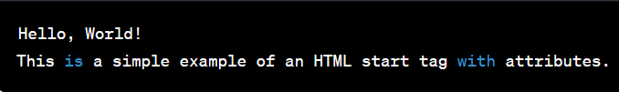
Day-2 Workshop on Web Tech
PROGRAM-1
Implementing HTML program that represent in the document as a start tag, which gives the name and attributes.
<!DOCTYPE html>
<html>
<head>
<title>Start Tag Example</title>
</head>
<body>
<h1 id="main-heading" class="header">Hello, World!</h1>
<p>This is a simple example of an HTML start tag with attributes.</p>
</body>
</html>
Mr. Amar Pal Yadav Workshop on Web. Tech. Day-2

Slide 38
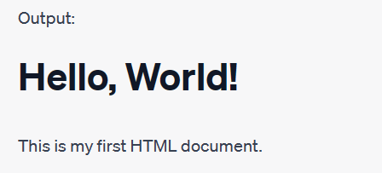
Day-2 Workshop on Web Tech
PROGRAM-2
Implementing HTML program that represents a document
<!DOCTYPE html>
<html>
<head>
<title>My First HTML Document</title>
</head>
<body>
<h1>Hello, World!</h1>
<p>This is my first HTML document.</p>
</body>
</html>
Mr. Amar Pal Yadav Workshop on Web. Tech. Day-2

Slide 39
Day-2 Workshop on Web Tech
PROGRAM-3
Implementing HTML program to display your simple CV
<!DOCTYPE html>
<html>
<head>
<title>My CV</title>
</head>
<body>
<div style="text-align: center;">
<h1>John Doe</h1>
<p>Web Developer</p>
</div>
<h2>About Me</h2>
<p>I am a passionate web developer with a strong foundation in HTML, CSS, and JavaScript. I love creating engaging and user-friendly websites that provide value to users.</p>
Mr. Amar Pal Yadav Workshop on Web. Tech. Day-2

Slide 40
Day-2 Workshop on Web Tech
<h2>Experience</h2>
<h3>Front-end Developer - XYZ Tech (2019 - Present)</h3>
<p>At XYZ Tech, I've been responsible for developing responsive and interactive web interfaces. Collaborated with the design and backend teams to ensure seamless integration of features.</p>
<h3>Freelance Web Developer (2017 - 2019)</h3>
<p>Worked on various freelance projects, building websites for small businesses and individuals. Managed projects from concept to delivery, ensuring client satisfaction.</p>
<h2>Education</h2>
<h3>Bachelor's Degree in Computer Science - University of ABC (2015 - 2019)</h3>
<p>Studied computer science with a focus on web development. Took courses in algorithms, database management, and user experience design.</p>
Mr. Amar Pal Yadav Workshop on Web. Tech. Day-2

Slide 41
Day-2 Workshop on Web Tech
<h2>Skills</h2>
<ul>
<li>HTML5, CSS3, JavaScript</li>
<li>Responsive Web Design</li>
<li>Front-end Frameworks (e.g., Bootstrap)</li>
<li>Version Control (Git)</li>
<li>Problem Solving and Algorithm Design</li>
</ul>
<h2>Contact</h2>
<p>Email: john@example.com</p>
<p>Phone: (123) 456-7890</p>
</body>
</html>
Mr. Amar Pal Yadav Workshop on Web. Tech. Day-2

Slide 42
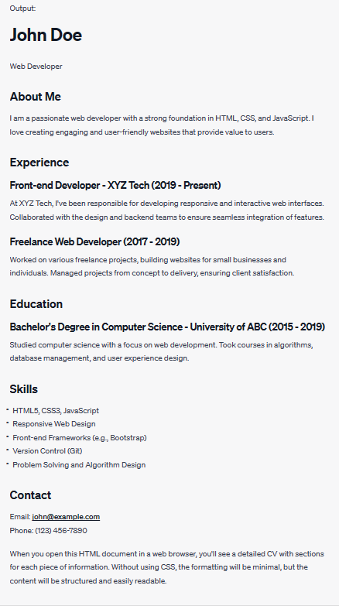
Day-2 Workshop on Web Tech
Mr. Amar Pal Yadav Workshop on Web. Tech. Day-2

Slide 43
Day-2 Workshop on Web Tech
PROGRAM 4
Creating html document that represents document object model
<!DOCTYPE html>
<html>
<head>
<title>DOM Example</title>
</head>
<body>
<header>
<h1 id="main-heading">Welcome to My Website</h1>
</header>
<nav>
<ul>
<li><a href="#">Home</a></li>
<li><a href="#">About</a></li>
<li><a href="#">Services</a></li>
<li><a href="#">Contact</a></li>
</ul>
Mr. Amar Pal Yadav Workshop on Web. Tech. Day-2

Slide 44
Day-2 Workshop on Web Tech
</nav>
<main>
<section id="about">
<h2>About Me</h2>
<p>I am a web developer with a passion for coding.</p>
</section>
<section id="services">
<h2>Services</h2>
<ul>
<li>Web Design</li>
<li>Front-end Development</li>
<li>Responsive Design</li>
</ul>
</section>
</main>
<footer>
<p>&copy; 2023 My Website. All rights reserved.</p>
</footer>
</body>
</html>
Mr. Amar Pal Yadav Workshop on Web. Tech. Day-2

Slide 45
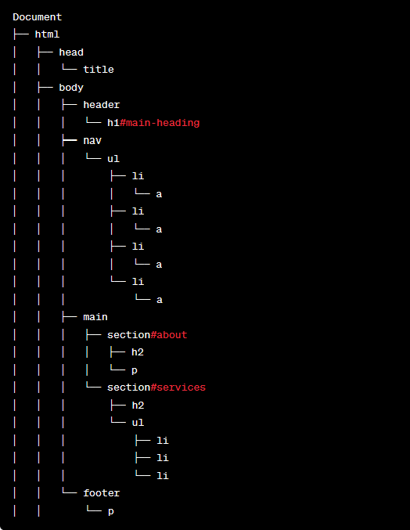
Day-2 Workshop on Web Tech
Mr. Amar Pal Yadav Workshop on Web. Tech. Day-2

Slide 46
Day-2 Workshop on Web Tech
PROGRAM 5
To Create a table to show your class time table.
<!DOCTYPE html>
<meta charset="utf-8">
<meta name="viewport" content="width=device-width, initial-scale=1">
<html lang="en">
<head>
<title>HTML table</title>
</head>
<body> <table border="1">
<tr> <th>Day/Time</th>
<th>9-10</th>
<th>10-11</th>
<th>11-12</th>
<th>12-1</th>
<th>1-2</th>
<th>2-3</th>
<th>3-4</th> <th>4-5</th>
</tr>
Mr. Amar Pal Yadav Workshop on Web. Tech. Day-2

Slide 47
Day-2 Workshop on Web Tech
<tr>
<th rowspan="2">Monday</th>
<td>SE</td>
<td>Elective</td>
<td>CN</td>
<td>EITKL</td>
<th rowspan="10">Lunch</th>
<td>Elective</td>
<td>Elective</td>
<td>CN</td>
</tr>
<tr>
<td>XYZ</td>
<td>XYZ</td>
<td>XYZ</td>
<td>XYZ</td>
<td>XYZ</td>
<td>XYZ</td>
<td>XYZ</td>
</tr>
Mr. Amar Pal Yadav Workshop on Web. Tech. Day-2

Slide 48
Day-2 Workshop on Web Tech
<tr>
<th rowspan="2">Tuesday</th>
<td colspan="2">Club Coding & Training</td>
<td colspan="2">Mini Project</td>
<td>SE Lab</td>
<td>DM</td>
<td>CN</td>
</tr>
<tr>
<td colspan="2">XYZ</td>
<td colspan="2">XYZ</td>
<td>XYZ</td>
<td>XYZ</td>
<td>XYZ</td>
</tr>
Mr. Amar Pal Yadav Workshop on Web. Tech. Day-2

Slide 49
Day-2 Workshop on Web Tech
<tr>
<th rowspan="2">Wednesday</t>
<td>SE</td>
<td>DM</td>
<td>CN</td>
<td>Elective</td>
<td>Elective</td>
<td>SE</td>
<td>MOOCS</td>
</tr>
<tr>
<td>XYZ</td>
<td>XYZ</td>
<td>XYZ</td>
<td>XYZ</td>
<td>XYZ</td>
<td>XYZ</td>
<td>XYZ</td>
</tr>
Mr. Amar Pal Yadav Workshop on Web. Tech. Day-2

Slide 50
Day-2 Workshop on Web Tech
<tr>
<th rowspan="2">Thursday</th>
<td>CN</td>
<td>MOOCs</td>
<td colspan="2">CN Lab</td>
<td>SE</td>
<td>DM</td>
<td>Elective</td>
</tr>
<tr>
<td>XYZ</td>
<td>XYZ</td>
<td colspan="2">XYZ</td>
<td>XYZ</td>
<td>XYZ</td>
<td>XYZ</td>
</tr>
Mr. Amar Pal Yadav Workshop on Web. Tech. Day-2

Slide 51
Day-2 Workshop on Web Tech
<tr>
<th rowspan="2">Friday</th>
<td colspan="2">Competitive Coding</td>
<td>EITKL</td>
<td>SE</td>
<td>SE Lab</td>
<td>Elective</td>
<td>Elective</td>
</tr>
<tr>
<td colspan="2">XYZ</td>
<td>XYZ</td>
<td>XYZ</td>
<td>XYZ</td>
<td>XYZ</td>
<td>XYZ</td>
</tr> </table> </body>
</html>
Mr. Amar Pal Yadav Workshop on Web. Tech. Day-2

Slide 52
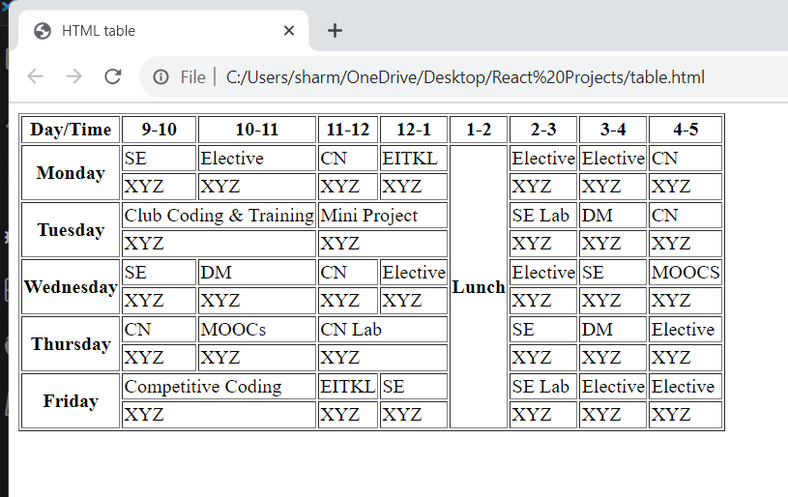
Day-2 Workshop on Web Tech
Mr. Amar Pal Yadav Workshop on Web. Tech. Day-2

Slide 53
Day-2 Workshop on Web Tech
:Program for Homework:
6. Implementing HTML program that for Heading
7. Implementing program that implement paragraph and line-break
8. Use tables to provide layout to your HTML page describing your college infrastructure.
9. Use <span> and <div> tags to provide a layout to the above page instead of a table layout
Mr. Amar Pal Yadav Workshop on Web. Tech. Day-2

Slide 54

Mr. Amar Pal Yadav Workshop on Web. Tech. Day-2

